Slide 1
Filling the Vacuum?
An analysis of Labor’s 18th May 2019 Election loss.

Slide 2
The Authors.
Methodology used by Authors
John Collins
Vince O’Grady
Harvard Business School Case Study
Prepared July 2019.

Slide 3
Harvard Business School case Study Methodology.
Product. which is Labor’s Policy platform
Price. How it affects the Person and/or the budget
Promotion. The messages to be distributed re the Policy and the Labor party.
Place. The methodology of spreading the message. Particularly the medium used.

Slide 4
Market Segmentation
Three Segments chosen after analysis.

Slide 5
The Segments Chosen (1)
15 Years to 35 Years.
Characteristics.
Being Educated
Looking for part time Employment (whilst Studying)
Looking for full time employment (after Study)
Aspirations. Family/Home/good job/Hope/expectations

Slide 6
The Segments Chosen (2)
36 Years to 59 Years.
Characteristics.
Educated
In part time Employment
Underemployed.
Looking for full time employment (after Study)
Aspirations. Family/Home/good job/Hope/expectations

Slide 7
The Segments Chosen (3)
60 Years plus.
Characteristics.
Educated
Retired
Enough to live on and also support children
Super as a bank.
Busy with Children and grandchildren
Travel
Aspirations. Family/Home/good job for children/Hope/expectations

Slide 8
The Segments Chosen (4) Extra.
The female population.
In the 2016 census the female population of Australia was 50.7%
Important because of
Inequality with wage parity
Retirement income
Domestic violence.

Slide 9
Labor Policies.
173 Policies
In no Order
Color coded (in No order)
Too Many?
Large Target?

Slide 10
Policy Example.
Confusing Electorate by too many messages.
Not negating Coalition Negative messages.
Not negating Perception driven messages.
Keeping it simple.

Slide 11
SWOT.
Strengths.. Excellent policy developed.
Weaknesses.. Policies not related to segments and no ongoing message. Too complicated.
Opportunities.. Fix the specific weakness in the ongoing message and the targeted Policy messaging. Align with defined segments.
Threats.. If Labor don’t do this then forget changing society. Doesn’t happen from Opposition.

Slide 12
Messages relating to Segment 1.
Segment 1 15 to 35 years.
Newstart.
Inquiry not enough ($3.3Bn a year was affordable)
Represents approx 1million people or 6.6% of voting population.
A conservative estimate.

Slide 13
Messages relating to Segment 1.
This segment consists of 6,356,837 persons and represents 33.38% of the voting population of 19,039,287.
(Data from ABS 2016 Census and AEC website 2019 Election).

Slide 14
Messages relating to Segment 2.
Segment 2 36 to 59 years.
Newstart.
Sons and daughters
Have to support own adult children
A conservative estimate would be another 10% of voting population who would have to look after their kids. (Via Census).

Slide 15
Messages relating to Segment 2.
This segment consists of 7,704,274 persons and represents 40.46% of the voting population of 19,039,287.
(Data from ABS 2016 Census and AEC website 2019 Election).

Slide 16
Messages relating to Segment 3.
Segment 3 60 Years plus
Retirement incomes.
Franking Credits
Pensions
Super (Industry and financial)
SMSF.
Confusing Message
Lies told.

Slide 17
Messages relating to Segment 3.
This segment consists of 4,976,160 persons and represents 26.13% of the voting population of 19,039,287.
(Data from ABS 2016 Census and AEC website 2019 Election).

Slide 18
Messages relating to segment 4.
Female Voting Population
Domestic Violence
Wage parity
Retirement incomes
Supporting children on Newstart.
Segment 4 Represents 51% of voting population.

Slide 19
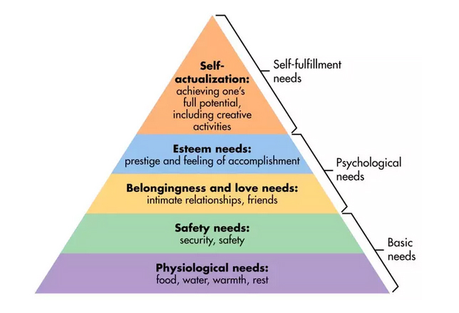
Maslow’s Hierarchy of Needs

Slide 20
Perception of Unions and Labor.
Continual Coalition Message re Unions and Labor
Liberal “Stock” message of Thuggish Unionism.
Association of Unions with Labor. (Therefore thugs)
Union Control of Labor
Coming for your money/Can’t control money
Labor’s debt.

Slide 21
Perception of Unions and Labor.
Unions and Labor’s response to Liberal message of thuggish behaviour and not able to control money.
Q. What is that response?
A. Less than optimal.

Slide 22
Perception of Unions and Labor.
Newstart. Unions and Labor don’t care about those unemployed....directly contrary to Labor values.
Franking Credits. Badly explained and with Coalition messages running interference and telling lies.......directly contrary to labor Values.
Adani Mine. Labor against Jobs......directly contrary to Labor values.

Slide 23
Fattening the Pig before the Fair

Slide 24
Two Message types missing.
A general message of who we are (Unions and Labor)
Specific messages about individual policies which reinforce who we are.

Slide 25
Specific Diet of
Who we are
What we do

Slide 26
Tasty snacks of
Individual messages for policies
Congruent with special diet.

Slide 27
Outcome.
We now have a fattened Pig ready to sell at the fair (Federal Election)

Slide 28
Some Suggestions
Labor Party and ACTU develop a series of media for their members.
The story of the working class (1700’s)
Agricultural Revolution.
The story of the Landowning class
Making Laws in the Parliament
The continuing story of the working class
Industrial Revolution.

Slide 29
Some Suggestions (contd)
The Making of the combination Laws of 1799 and 1800
Repression of the working class.
The control of the Parliament and laws by the Landowners.
Enclosure of the common Lands and disenfranchisement of the Working man.

Slide 30
Some Suggestions (contd)
The lack of any Social Justice.
Poverty, crime and punishment.
Reduction in wages etc.
Formation of Unions (reasons for)
Formation of Labor Party (Representation of Unions in the Law making body Parliament)
Achievements for all Australians.
Blow trumpet.

